Slide 1

identity matters
Constructing Social Identities through Ontological Relationships
M. Cristina Pattuelli & Lisa Norberg
University of North Carolina at Chapel Hill
Dublin Core 2006
Manzanillo, Mexico
October 5, 2006

Slide 2
digital library collections @ unc
Began in 1996
Collections emphasize the history of the American South
Legacy of MARC data with LCSH
Intended audience was researchers
Growing interest in serving educators

Slide 3
history through social identity
According to current pedagogical theory, primary source materials are needed to support inquiry-based learning and develop critical thinking skills
One of the most effective methods used to teach history is to relate content from the past to the students’ personal experience
Notes:
“Young people’s perspective about the social world, like those of historians and teachers, are shaped by their identities as members of families, communities, regions, and nations, as well as by their affiliations with racial, ethnic, religious, and other groups” --Epstein & Shiller, 2005

Slide 4
what teachers want
Primary sources that offer different or comparative perspectives on historical events
Personalized stories, such as letters, diaries, personal narratives from the past that put historical events into more meaningful context
Primary sources that students can relate to from a geographical, familial, or social perspective
Smaller “chunks” of learning materials that can be reused and repurposed for different instructional uses

Slide 5
digital educational content @ unc
“A learning object is an independent and self-standing unit of learning content that is predisposed for reuse in multiple instructional contexts.” -- Polsani, 2003
Intended for students or independent learners
Instructional objects are small “chunks” of primary source materials ranging from single images to text or audio excerpts that are can be used in multiple instructional contexts
Intended for instructors at all levels

Slide 6
family matters
Harriet Jacobs
  First woman to author a fugitive slave narrative in the United States
  Born in Edenton, North Carolina
  Wrote under the pseudonym “Linda Brent”
  Because of the scandalous nature of her narrative, she masked the identity of the people and places, including her birthplace and members of her family
John Jacobs
  Brother of Harriet Jacobs
  Also born into slavery in Edenton, North Carolina
  Separated from his sister and lived with various slave-owners until escaping to the North
  His experience was very different from that of his sister, but compared to his sister, his narrative is relatively unknown

Slide 7
the problem
Full text keyword searching and traditional subject metadata often fail to identify aspects of the content that would help in reconstructing social identity

Slide 8
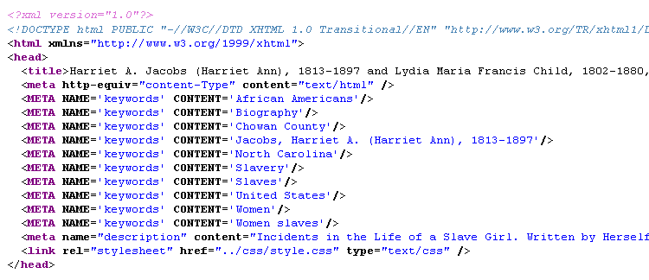
bibliographic subject metadata used for harriet’s narrative
No mention of her brother

Slide 9
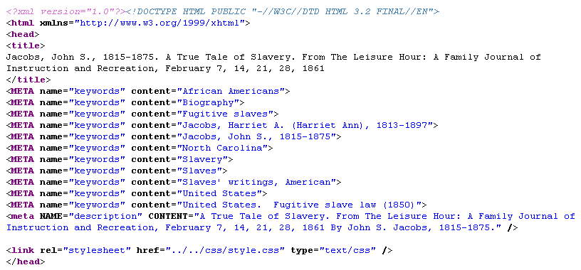
bibliographic subject metadata used for john’s narrative
Harriet is mentioned but their relationship is not expressed
No mention of Edenton or Chowan County

Slide 10
the challenge
How do we annotate discrete units of digital content so they can be retrieved in ways that are more useful for educators?

Slide 11
our strategy: ontology-based metadata
Apply application profile based on DC + selected IEEE LOM elements or the DC—Education Application Profile
Annotate the digital objects with metadata that are semantically ground into a domain ontology of North Carolina history
The ontology would formally represent the concepts and the relationships between them
Relationships most useful to educators, including social, familial, spatial, and temporal, would be implemented

Slide 12
semantic empowerment
Leveraging the semantics of ontology-based metadata to:
relate
aggregate
contextualize
Enabling more sophisticated
search
aggregation
navigation

Slide 13
spatial relationships
is-part-of
Country
  State
    Region
      County
        City/town
United States
  North Carolina
    Piedmont Region
      Chowan County
        Edenton

Slide 14
familial relationships
family
parent-of
brother-of
sister-of
relative-of

Slide 15
social relationships
owned-by/owns
person
free
slave
slaveholder

Slide 16
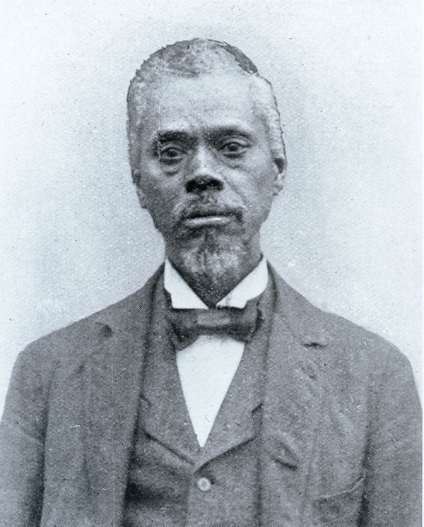
constructing social identity
Wilson Caldwell, Undated North Carolina Collection Photographic Archives

Slide 17

constructing social identity
slave-of
D. Swain
Rose
Civil War
has-lastname
president-of
mother-of
Emancipation
prior-to
Wilson
works-at
after
has-lastname
president-of
father-of
November
slave-of
J. Caldwell

Slide 18
drawing inferences
Wilson Swain and Wilson Caldwell were the same person
Slaves do not have family names, but inherit the surnames of their slave-owners
Slave ownership was based on maternity, rather than paternity
There may have been a social stigma attached to having your mother’s slave-owner’s name
Slaves worked at the University
Two presidents of UNC were slave-owners

Slide 19
next steps
Model the relationships as part of the development of the North Carolina history ontology
Identify a knowledge representation formalism suitable for the implementation of the ontology
  Most likely OWL DL
Determine whether the ontology should be used to “bootstrap” the subject metadata that already exists or be used to supplement or enhance traditional subject metadata

Slide 20
“Only through knowing our audience, respecting their needs, and imaginatively reengineering our operations, can we revitalize the library’s suite of bibliographic services.”
-- University of California Libraries Report, 2005
final thought

Slide 21
questions?
Cristina Pattuelli
pattm@email.unc.edu
Lisa Norberg
lnorberg@email.unc.edu
Thank you.

